Slide 1
IBM University Engagement Project Submission
“Exploring the Power of Agentic AI with IBM Cloud and Orchestrate”

Slide 2

Project Tile – Sequential Task Agent – Investment Analyst
Domain of Project - FINANCE
Student Name | Recent Passport Photo | Email ID | Mobile number [WhatsApp]
SHREYA LAXMAN KOLEKAR |  | shreyakolekar06@gmail.com | 8208381534

Slide 3
Problem Statement - Sequential Task Agent – Investment Analyst
The Challenge Investment analysts need to process multiple layers of information—financial reports, stock performance data, market news, and analyst opinions. Much of this information is fragmented and requires a sequence of tasks (data gathering, validation, analysis, comparison, and reporting) to generate useful insights. Manual workflows are time-consuming and prone to errors. The challenge is not just to collect market data but to automate sequential tasks that lead to actionable investment recommendations. The Objective Build a Sequential Task Agent that acts as an intelligent investment analyst. The solution should:
Automate Data Gathering: Collect financial data from multiple trusted sources such as company reports, stock exchanges, and market news feeds.
Perform Multi-Step Analysis: Sequentially process data (e.g., extract KPIs → calculate financial ratios → benchmark against competitors → analyze market sentiment).
Generate Predictive Insights: Identify trends, detect risks, and provide forward-looking recommendations (e.g., “Stock X shows declining margins—consider underweighting in portfolio”).
Deliver Structured Reports: Provide an easy-to-understand dashboard with investment summaries, trend charts, risk indicators, and AI-generated recommendations. Tech Stack (Mandatory) • IBM Langflow / IBM Orchestrate + IBM Models

Slide 4
Proposed Solution -
AI-Powered Investment Analyst Agent
Our solution is a multi-agent AI system that automates investment research and analysis.
Workflow:
Collect financial data from trusted sources
Extract KPIs and financial metrics
Calculate ratios and performance indicators
Compare companies with industry peers
Analyse market sentiment and risks
Generate investment recommendations
Key Agents:
Financial Data Agent
KPI Extraction Agent
Sentiment Analysis Agent
Benchmarking Agent
Recommendation Agent
Output: Interactive dashboard with financial insights, risk scores, trend analysis, and Buy/Hold/Sell recommendations.

Slide 5
Technology Used
Langflow platform -For designing and orchestrating multi-agent workflows visually
IBM Granite model - for eg – ibm-granite-3-2-8b – For natural language understanding, reasoning, and personalization
IBM Cloud – It provides the infrastructure to build, deploy, and scale the Nutrition Agent efficiently. IBM Cloud enables a reliable, secure, and scalable environment for deploying the Nutrition Agent.
RAG– RAG to fetch real data first, then generate intelligent answers, making the Nutrition Agent more trustworthy and effective.
IBM Watsonx.ai - For model deployment, embeddings, and AI governance
IBM BOB AI

Slide 6
Orchestrate component Used -
Chat Input – Accepts user investment queries
IBM watsonx AI Agent – Coordinates workflow
Granite-4.0-8B-Instruct – Financial analysis and reasoning
Chat Output – Displays reports and recommendations
File Component – Stores financial reports
RAG Retrieval Component – Retrieves relevant financial information

Slide 7
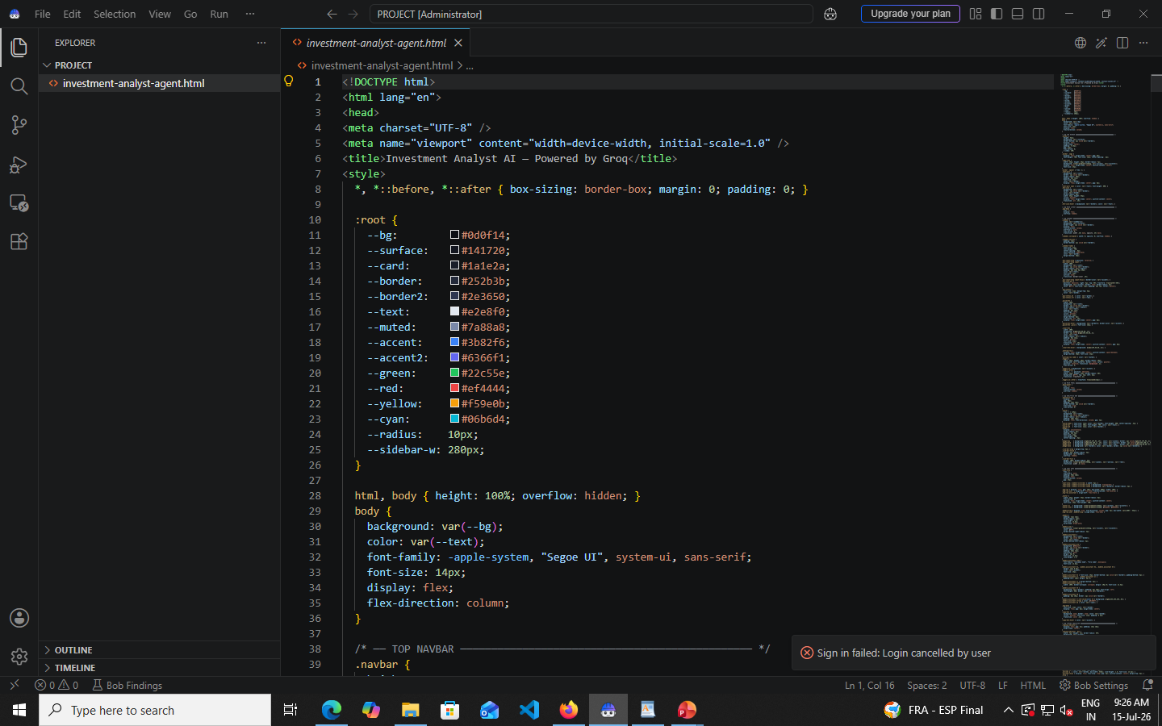
Agent Instructions Screenshot-

Slide 8
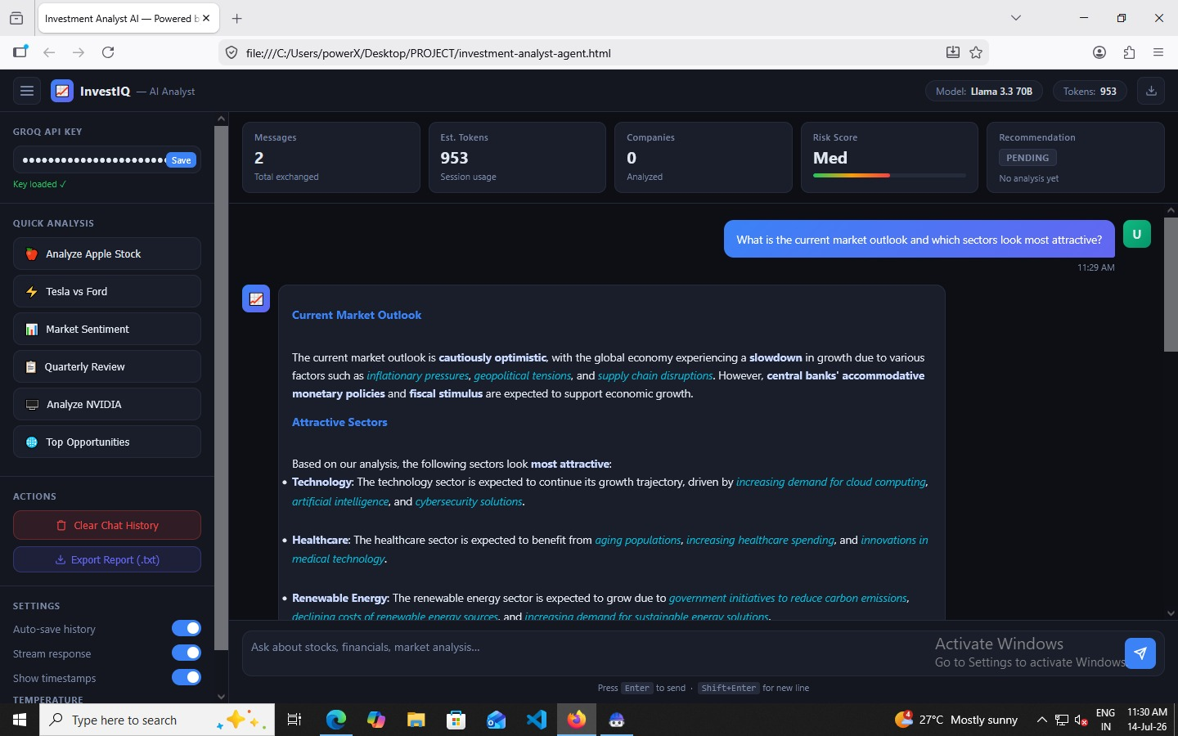
Prompt with output Screenshot:

Slide 9

Role of Agentic AI in the solution
Role of Agentic AI in Nutrition Agent
Agentic AI enables the Nutrition Agent to function as an intelligent, autonomous system rather than a simple chatbot. Using IBM watsonx.ai and IBM Granite models, it coordinates multiple specialized agents to deliver personalized nutrition guidance.
Each agent performs a specific role—such as retrieving nutritional data, generating diet plans, providing health advice, and analyzing food logs—while working collaboratively. This multi-agent approach ensures efficient task execution and accurate results.
Agentic AI also brings context awareness, understanding user details like age, health conditions, and fitness goals to generate tailored recommendations. It supports real-time adaptation, continuously updating suggestions based on user inputs like daily meals.
Additionally, agents communicate with each other, enabling better decision-making and improved outcomes.
Overall, Agentic AI makes the system proactive, personalized, and goal-driven, acting like a smart digital nutritionist that helps users maintain a healthy lifestyle.

Slide 10
Novelty and Uniqueness
Key Innovations
Multi-agent sequential analysis workflow
RAG-powered financial intelligence
Automated KPI and ratio calculation
Real-time market sentiment analysis
Competitor benchmarking
AI-generated investment recommendations
Scalable IBM watsonx.ai architecture
Unlike traditional stock screeners, the system provides end-to-end investment research and actionable insights.
Future Scope
Portfolio management integration
Real-time market monitoring and alerts
Advanced stock price forecasting
Support for global markets and cryptocurrencies
Voice-enabled investment assistant
Personalized investment strategies
These lengths are much closer to what judges typically expect in hackathon/IBM project PPTs—around 5–8 bullet points per slide instead of paragraphs.

Slide 11
Future Scope
Portfolio management integration
Real-time market monitoring and alerts
Advanced stock price forecasting
Support for global markets and cryptocurrencies
Voice-enabled investment assistant
Personalized investment strategies
·

Slide 12
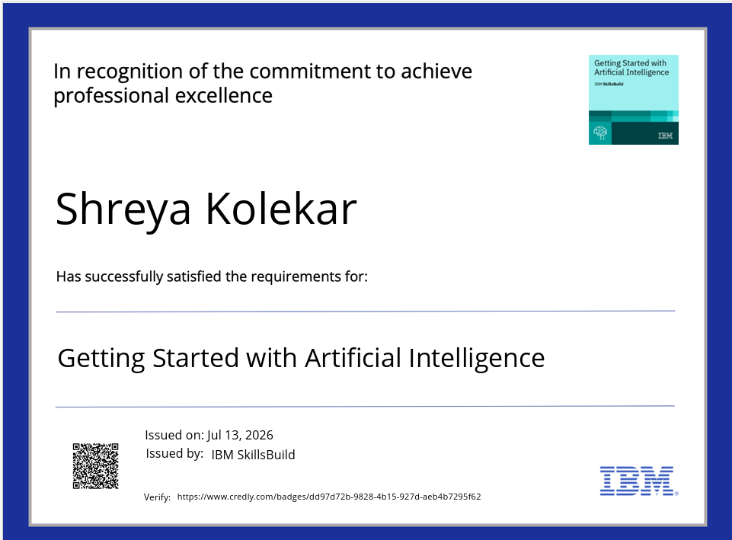
Certificates Earned:

Slide 13
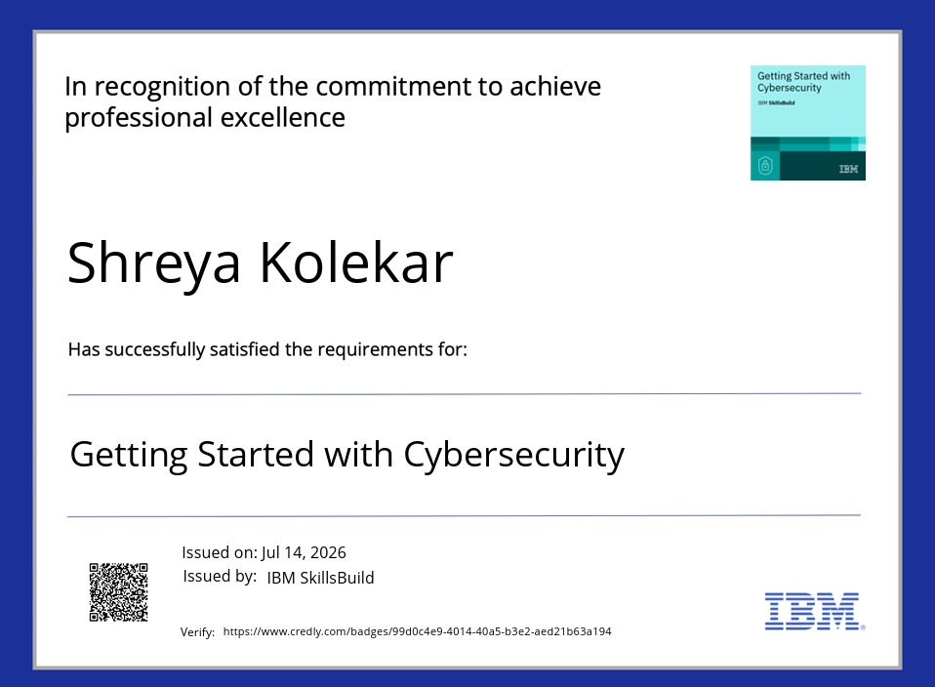

Slide 14
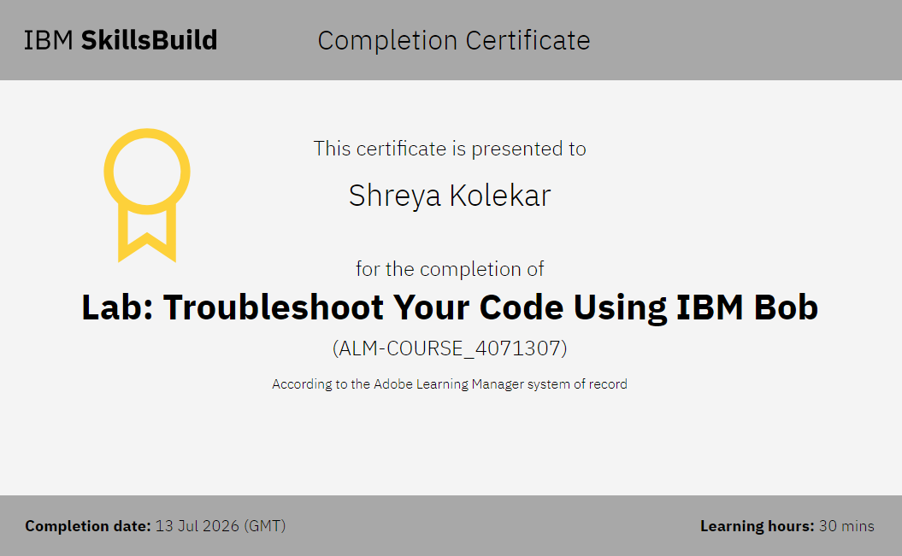
Certificates Earned:​

Slide 15
Git Hub Link
Please create public github repository (Enable Add README button while creating repository) with format –
Please test and Paste the working Github URL –ShreyaKolekar/Investment-analyst-AI: A multi-agent AI system that automates investment research and analysis.
·
·
·

Slide 16


